Slide 1

Business Analytics

Slide 2
Which sector has highest total revenue?
Consumer Discretionary Industry has highest revenue, also it has steep growth in terms of revenue but it is less steeper than the Health Care industry.

Slide 3
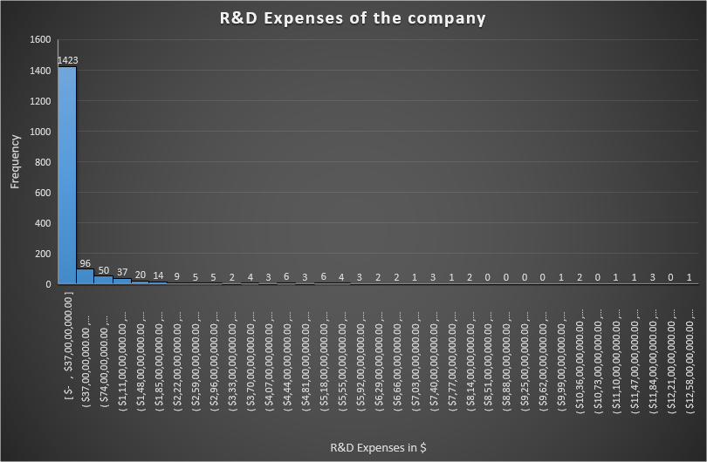
Expenses of the companies on Research & Development
This is the Histogram of the total R&D expenses of the companies.
The Histogram is right or positively skewed which means that the mean is higher than the median.
Mean for the R&D expenses of $363 million while median is $0. The standard deviation for the expenses is $1.2 billion which means that the R&D expenses are highly spread over it’s range of $12 billion as the median is $0 which there are very few companies who is actually spending money on R&D

Slide 4
Growth in Consumer Discretionary Industry
Consumer Discretionary Industry Revenue has grown tremendously from 2012 to 2013. However, not quite significant increase in revenue after 2013.

Slide 5
Growth in Home Retail improvement market
Home Retail improvement market has great growth for the given four years.

Slide 6
Home Depot vs Lowe’s
Home Depot being the big player in the Home Retail improvement have large revenue. However, both the companies are making great improvement each year.

Slide 7
Which company has steeper growth in Home Improvement Retail?
From the graph we can easily say that not only Home Depot has higher total revenue but also steeper revenue growth. But the average of the total revenue is very lower than the revenue of the both the companies.

Slide 8

Thank You!!!

